Slide 1
GGPLOT AND PLOTLY DEMO
Hank Dorsey
Notes:
‹#›

Slide 2
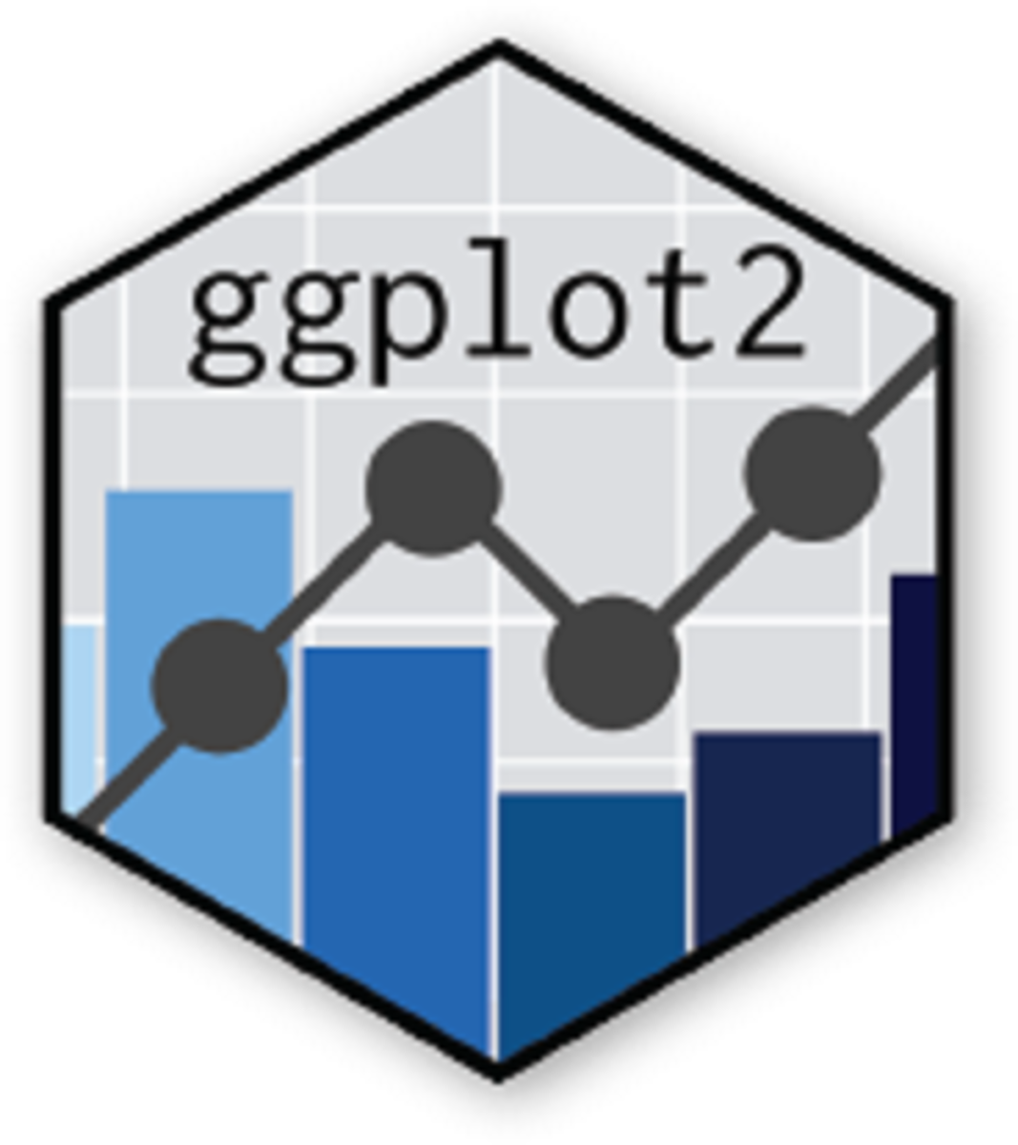
OVERVIEW
ggplot2 is a graphical library for creating “declarative graphics” using what ggplot2 calls the Grammar of Graphics
Two most important elements are the data and the ‘aesthetics’
Aesthetics (aes) can be thought of as a link between what’s in the data object and what will be displayed on your graph

Slide 3
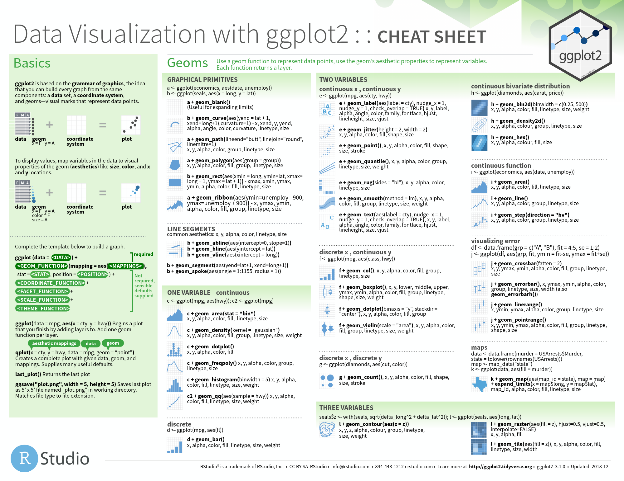
OVERVIEW

Slide 4
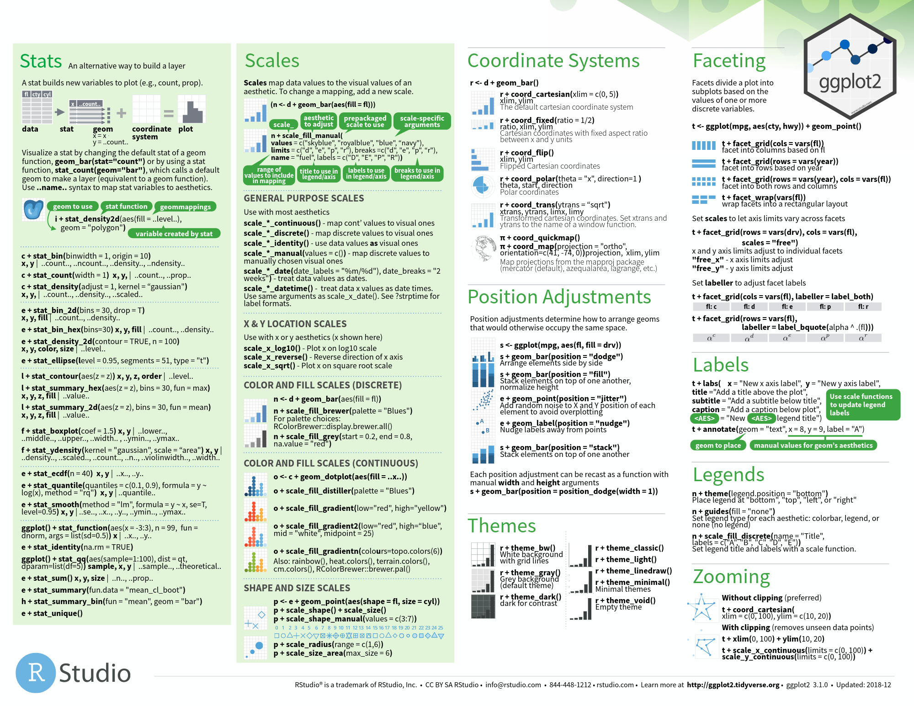
OVERVIEW

Slide 5

PLOTLY
Plotly can be used similarly ggplot, but focuses less on building a cohesive grammar and more on interactivity and high level flexibility
Also available in Python and Javascript, with extremely similar syntax
Can be a good way to explore those languages
Much more fickle than ggplot
Decent industry penetration

Slide 6
LINKS
Box:
Github: https://github.com/HenryDorsey/ggplot_plotly

